Slide 1

UBC Library Research Commons
NVivo:
Classifications, Datasets, Queries, and Visualizations 2021

Slide 2
Welcome to the Research Commons!
Workshops and One-on-one Consultations
Citation Management
R, SPSS
Data visualization
NVivo
…
Check the Website for more
Notes:
https://researchcommons.library.ubc.ca/nvivo-part-1-getting-started-with-nvivo/

Slide 3
Getting NVivo
UBC Library has NVivo on its computers (Room 217 and 218)
From Nov. 21, 2016, NVivo is available to UBC students, faculty and staff Instructions: https://it.ubc.ca/services/desktop-print-services/software-licensing/nvivo-pro-software
For new students, go to the following link (google- UBC On the Hub)
14-day free trial available to anyone at: http://www.qsrinternational.com/trial-nvivo

Slide 4

Learning Objectives
By the end of this session, you will be able to:
Import datasets into NVivo
Work with close-ended and open-ended answers in NVivo
Query the data:
Matrix
Crosstab
Coding
Create visualizations in NVivo

Slide 5
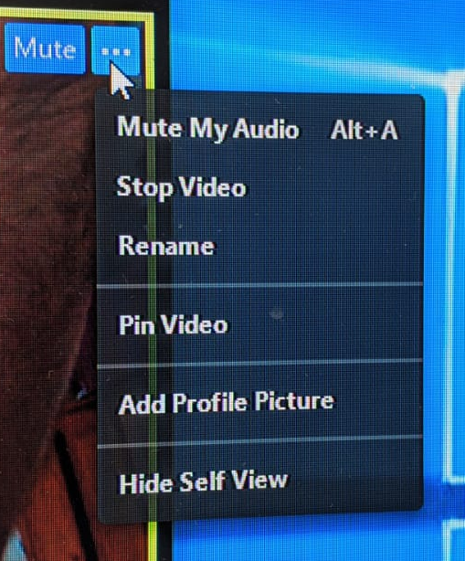

Add PC/MAC to Your Zoom Name
In order to direct you to the proper room—Mac or Windows—please change your name to include what version of NVivo you will be using:
Example:
Amir-Windows
Jeremy-Mac

Slide 6
Datasets
A collection of related sets of information that is composed of separate elements but can be manipulated as a unit by a computer (Wikipedia)
Their typical form is as spreadsheets.
Usually Survey Data (Excel, SurveyMonkey or Qualtrics)
But also: responses from social media data gathered from Facebook, LinkedIn or Twitter using NCapture.

Slide 7
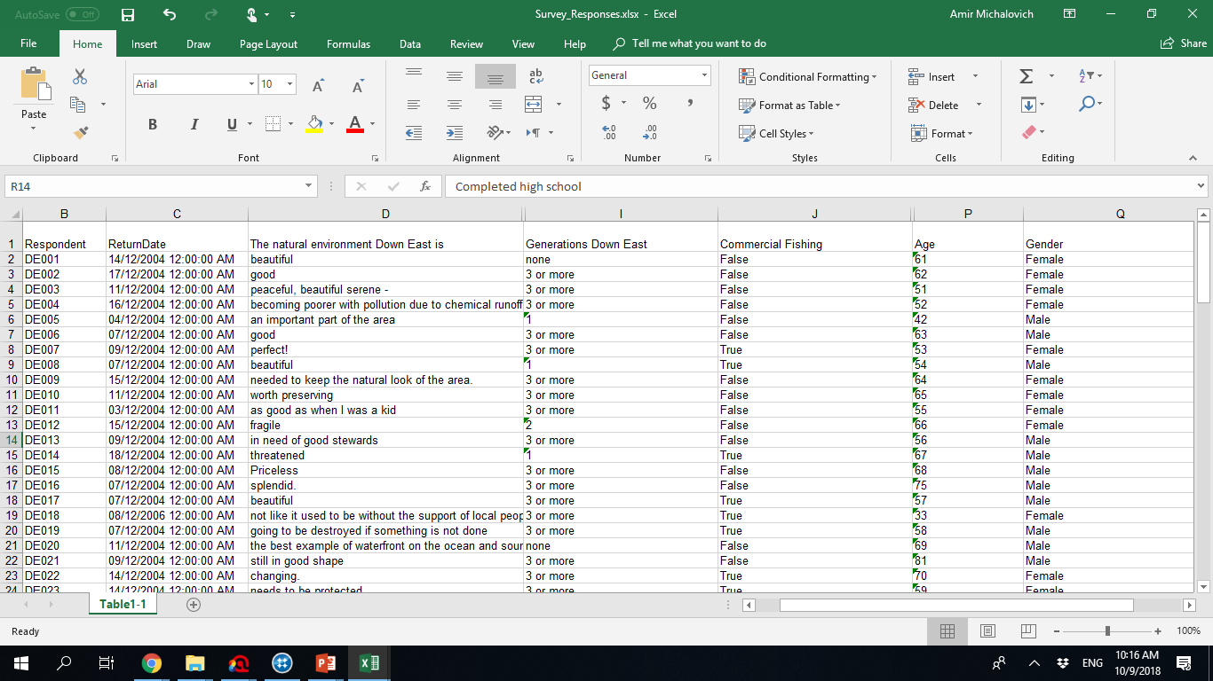
That’s what we mean:

Slide 8
Headers (Preferably Row 1)

Slide 9
Open- vs. close-ended questions
An open-ended question is designed to encourage a full, meaningful answer using the subject's own knowledge and/or feelings. It is the opposite of a closed-ended question, which encourages a short or single-word answer.
(Media College, accessed Oct.9, 2018)

Slide 10
Which is which? Chat Waterfall
O
C
C
C
C
Notes:
Ask students to annotate

Slide 11
Why distinguish?
Open-ended questions -> codable
Closed-ended questions -> automatically coded
Having both allows to ask focused questions:
Political views of participants above 50?
…. below 50?

Slide 12
Importance of Identifier
Not the real identity of a participant.
NVivo calls them Cases.

Slide 13
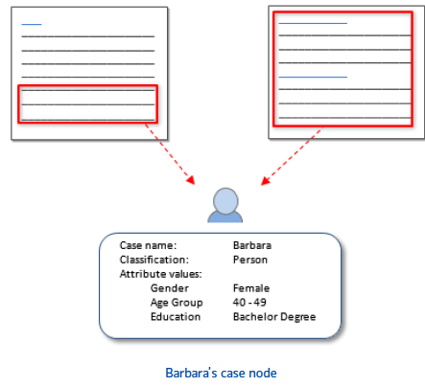
Cases
Cases are the 'units of observation' in your research study. They might represent people, places, events, organizations or other entities that you want to analyze and compare.
(NVIVO website)
Notes:
Cases: Just like thematic nodes, cases are containers to hold specific information, you use cases to represent the significant entities in your research. But unlike thematic nodes, cases allow you to integrate specific details for the information they contain, for example as a person (demographic information), location and add attributes for each particular descriptor.
For example, if you have created nodes for interview respondents and classified them as Person, you can double-click on the classification to quickly see the spread of your respondents.
Why code at nodes for themes and cases? Means you can answer questions with different criteria.

Slide 14
Attributes and Values
(close-ended questions by nature -> turn to Attributes)
Attribute: a type of quality, character, or characteristic ascribed to someone or something.
Value: the specific quality, character or characteristic ascribed…

Slide 15
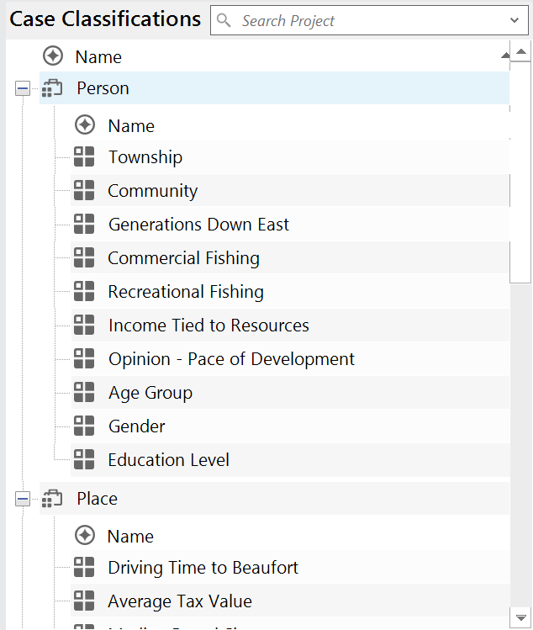
Case classifications
Case classification
Allow users to record descriptive information about people, places, organizations, or other ‘classifications’ in a project.
Attributes
Attribute
Case
Values
Notes:
**Use classifications to record descriptive information, like demographic details, about the cases in your project.
IN the image, we are seeing the example of creating classifications for each of the cases that have been created for the project (based on the intreviews)
You can use ‘node classifications’ to capture the demographic details of the people, places or other cases in your project. For example, if you have interviewed people in a particular community, you may want to collect information about their age, gender and occupation—and compare their responses based on these attributes. There are only 3 predefined Node Classifications inside NVivo for PC.
You can setup demographic data in NVivo or you can import it from a spreadsheet or text file.
Predefined classifications come with a set of attributes—for example, Person has attributes for age, occupation and so on. Custom classifications do not have default attributes but you can add your own.

Slide 16
Case classifications
Closed-ended question from survey data appear as attributes.
i.e. attribute names will be the headers of the close-ended questions
Notes:
**Use classifications to record descriptive information, like demographic details, about the cases in your project.
IN the image, we are seeing the example of creating classifications for each of the cases that have been created for the project (based on the intreviews)
You can use ‘node classifications’ to capture the demographic details of the people, places or other cases in your project. For example, if you have interviewed people in a particular community, you may want to collect information about their age, gender and occupation—and compare their responses based on these attributes. There are only 3 predefined Node Classifications inside NVivo for PC.
You can setup demographic data in NVivo or you can import it from a spreadsheet or text file.
Predefined classifications come with a set of attributes—for example, Person has attributes for age, occupation and so on. Custom classifications do not have default attributes but you can add your own.

Slide 17
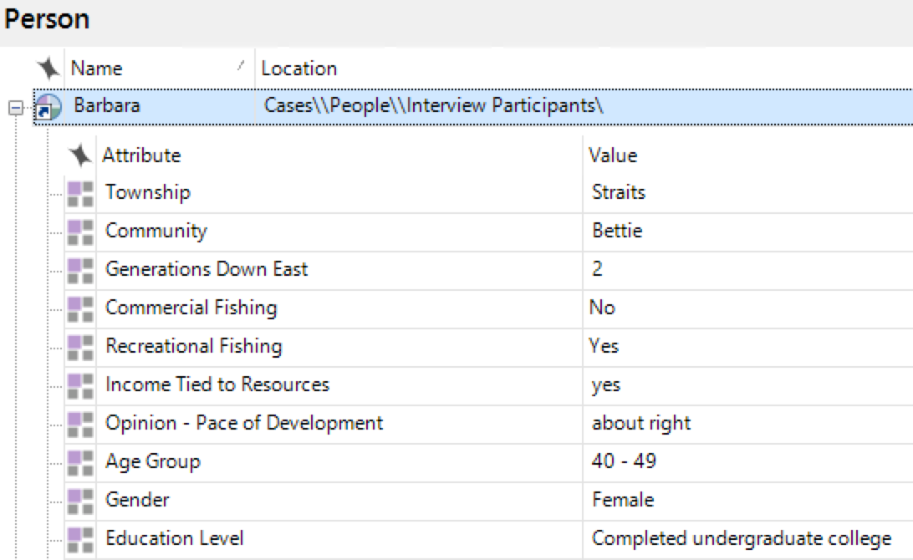
All together now
Case classification
Case
Attributes
Values
Notes:
EXPLAIN THAT FOR ‘PERSON’ AND ‘ORGANIZATION’ YOU GET AUTOMATIC ATTRIBUTES (TEMPLATE OF)

Slide 18
Match NVivo objects and their description
A container used to represent a single unit in an observation or analysis
Case classification
Case
Attribute
Value
Code
A type of quality, character, or characteristic ascribed to someone or something.
A container that stores demographic information about the units of observation/ analysis in the project.
A named concept that can be linked to other objects.
The specific quality, character or characteristic ascribed to someone or something.
Notes:
Annotate to match items

Slide 19
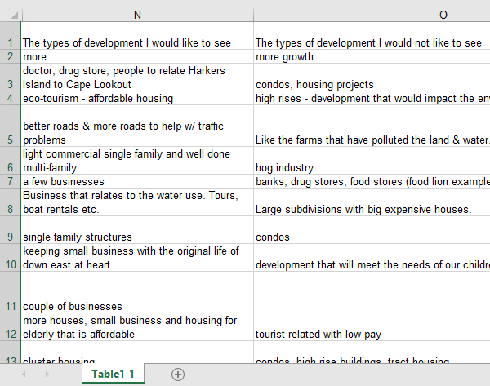
Open-ended data (turn to nodes)
NVivo will turn headers into codes automatically.
The resultant codes can further be coded with YOUR codes.

Slide 20
Task 1
Download the materials for Workshop 2 from
Sample Survey Responses (available in Chat Box)
Import the dataset into NVivo (we show how).
We explore next 2 slides: Table + Nodes

Slide 21
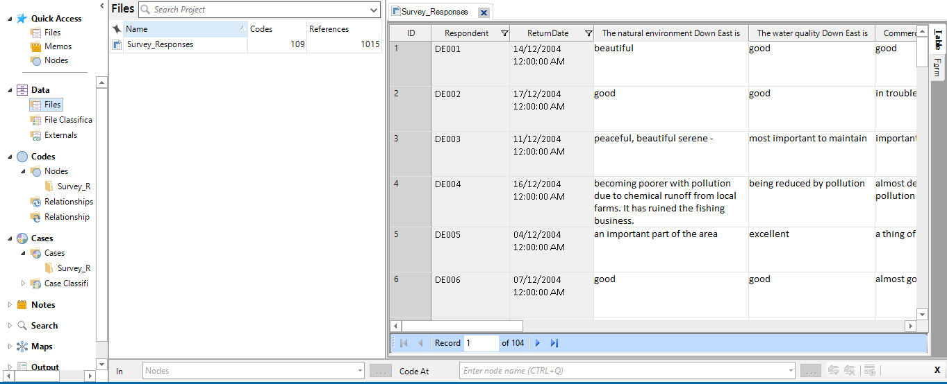
Dataset Table
Why use a table?
Why gray and white?
Where are the NVIVO automatic nodes?
What are the IDs for?
Why the ‘Form’ tab?
Notes:
What are IDs for? Code in teams (code the first 20 etc.)
Why the ‘Form’ tab? (perspective: respondent vs. researcher)

Slide 22
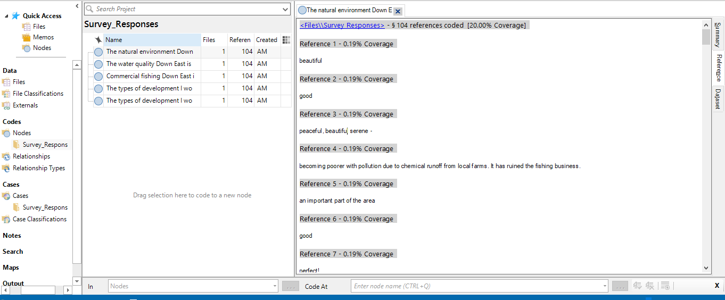
Coding open-ended answers
What are the automatic nodes here?
What are we coding?
Why are we coding it?
We could later ask:
Is “Water quality” (our nodes) present in answers to different questions (automatic nodes)? Why?
Notes:
Why the ‘Form’ tab? (perspective: respondent vs. researcher)

Slide 23
What is a query?
Find and analyze words or phrases in your sources, annotations and nodes
Ask questions and find patterns based on your coding and check for coding consistency among team members
Create new codes and/or visualize the results
Source: QSR International
Notes:
Queries provide a flexible way to gather and explore subsets of your data. In NVivo, you can create queries to
Find and analyze the words or phrases in your sources, annotations and nodes. You can find specific words or those that occur most frequently.
Ask questions and find patterns based on your coding and check for coding consistency among team members
Making the most of your queries
Start running queries early on in the coding process—they can help you focus on the questions you want to ask (and prompt you to code accordingly). For example, if you want to ask “How serious are the issues of water quality for local fishermen?”—make sure you code at the node for water quality and code at case nodes with the fisherman attribute.
Use coding queries to build-up and test ideas. For example, you have a hunch that people’s perception of water quality is closely tied to the pace of development. Create a query to gather all material coded at water quality where it is NEAR content coded at ‘development’.
Make a memo to record what you learn from a query—this can prompt you to ask further questions and facilitate deeper analysis. Link the memo to the query results.

Slide 24
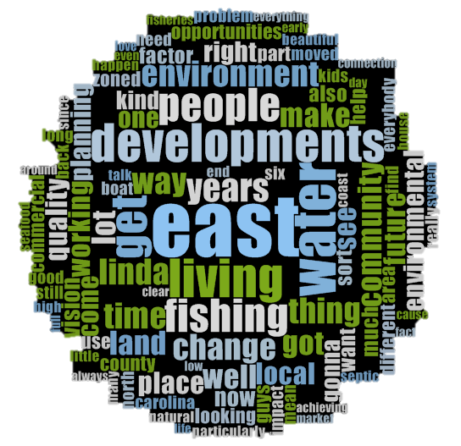
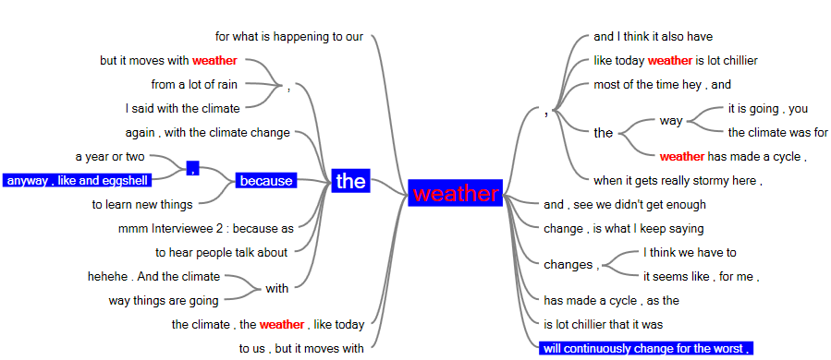
Queries we covered in Workshop 1
Word frequency
Text search

Slide 25
Queries we will cover today
?
Matrix
Crosstab
Coding

Slide 26
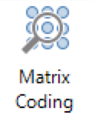
Matrix coding queries
Finds a combination of items (usually nodes or cases and attributes) and displays the results in an interactive table.
Allows you to ask a wide range of questions about patterns in the data and gain access to the content that shows those patterns.
Check how often interview respondents (case/s) refer to a particular topic or issue (node/s)
Check how many female and male respondents (attribute/s) refer to a topic or theme (node/s)
Code(s) X Code(s)
Code(s) X Attributes
Code(s) X Cases
Codes(s) X Files
…
…
…

Slide 27
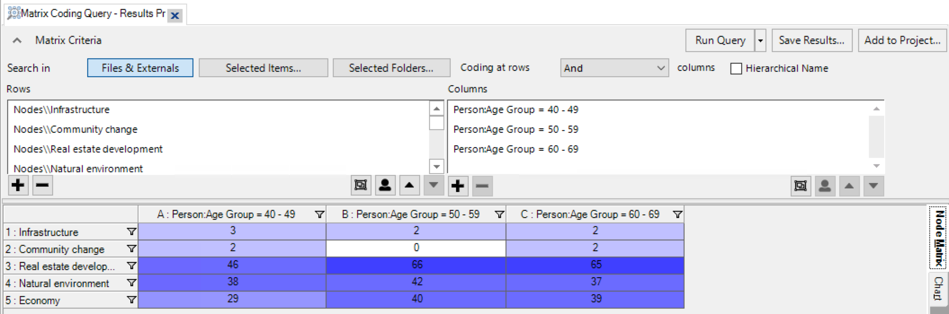
Nodes AND 1 attribute

Slide 28
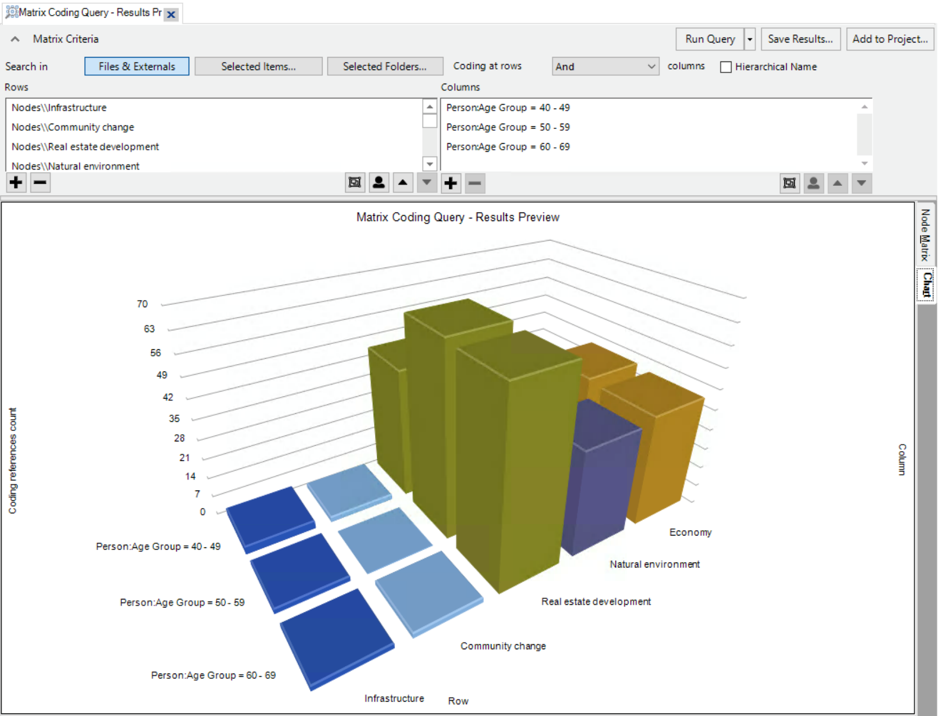
Nodes AND 1 attribute

Slide 29
Task 2
Close NVIVO and re-open it.
Create a Sample Project.
Run Matrix, Crosstab, and Coding queries

Slide 30
Visualizations in NVivo
Get started
Research design and data collection
Data analysis (coding)
Final write-up
Source: QSR International
Notes:
Get started—set out and review initial ideas, hunches or theories related to your research question.
Research design and data collection—show how you arrived at your approach to data collection and analysis.
Data analysis (coding)—encourage deep thought by helping you build your knowledge about your research topic and gain a greater understanding of your project items.
Final write-up—include visualizations in your memos to document your findings, and export image files to include in your report or presentation.

Slide 31
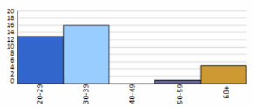
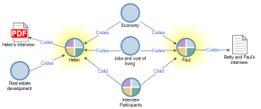
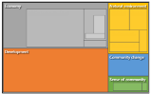
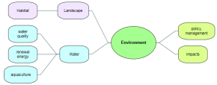
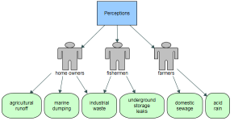
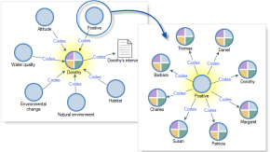
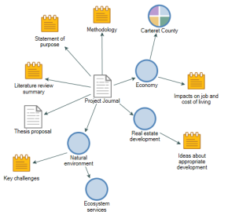
Visualizations in NVivo
Charts
Hierarchy charts
Mind maps
Concept maps
Project maps (not available on MAC)
Comparison diagrams
Explore diagrams
Source: QSR International
Notes:
Charts - Present or explore your project and coding.
Hierarchy charts - See patterns in your coding or view the attribute values of cases and files.
Mind maps - Brainstorm your ideas and visualize your thoughts.
Concept maps - Define concepts and think through their connections.
Project maps - Display the items and links in your project.
Comparison diagrams – See what two project items have in common and where they differ.
Explore diagrams – Show all the items connected to a single project item.

Slide 32
Task 3
Using the sample project:
Explore various saved visualizations in the Maps section.
Explore Charts (Chart Wizard and Hierarchy Chart)

Slide 33
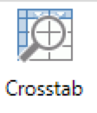
Crosstab queries
Adds a 2nd layer (attribute within an attribute)
Quicker and friendlier
For example:
Check how coding is distributed across the cases, or different types of cases in your project
Check how often female and male interview respondents with different educational levels refer to a particular topic or issue (node/s).
(sub attribute=gender)
(main attribute=educational level)

Slide 34
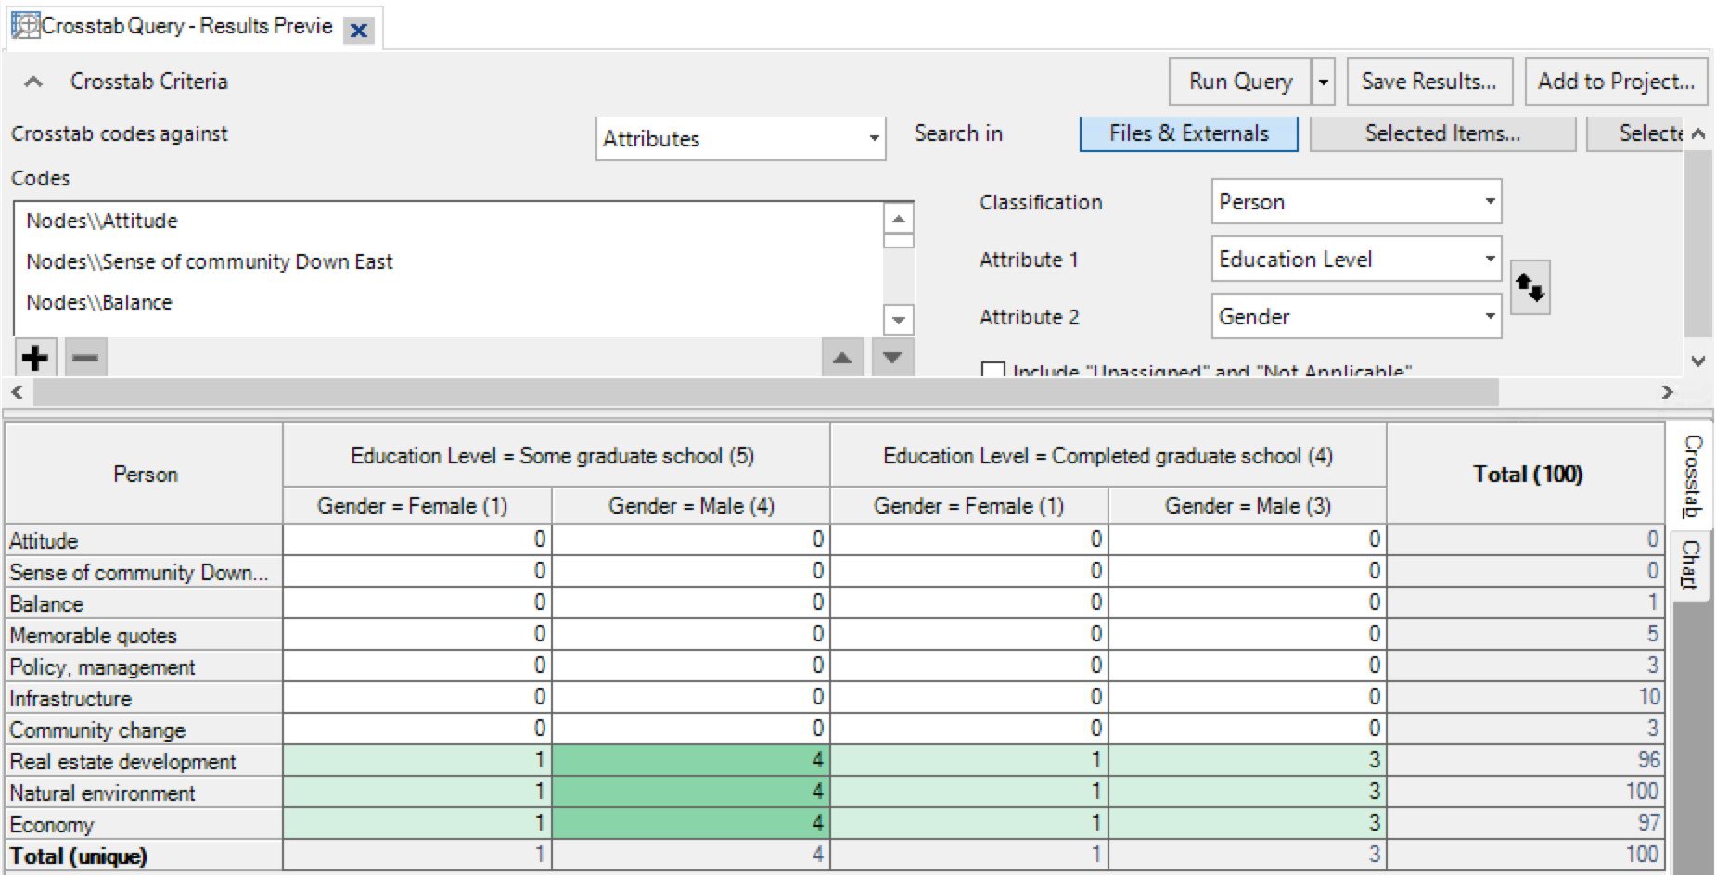
Nodes AND 2 attributes

Slide 35
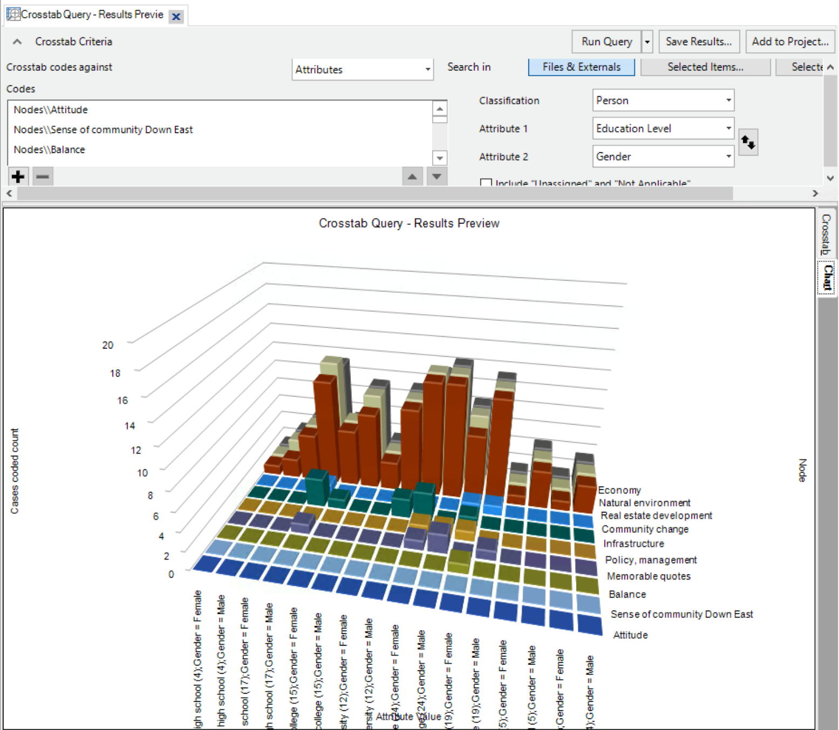
Nodes AND attributes

Slide 36
Task 3
In the Sample Project:
Run Cross-tab queries
What findings did you find?

Slide 37
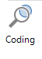
Coding queries
Ask any question and immediately get references (no tables).
Get all the references of female participants (attribute/s=gender, value/s=female) that relate to a particular topic or issue (node/s).
You can use more than one node or attribute or case…

Slide 38
Task 4
In the Sample Project:
Run a coding query!
Learn how to find a reference in its original context.
What findings did you find?

Slide 39
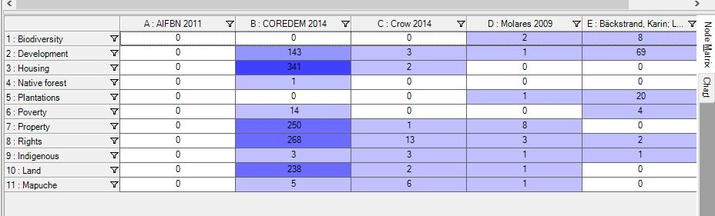
NVIVO’s Usefulness for Literature Reviews (show example)
Code for themes, definitions, findings, methodologies, stated gaps, epistemologies, locations (researchers, studies), etc.

Slide 40
NVIVO and Reference Managers
You can import references from your reference manager:
Refworks, Mendeley, Zotero, Endnote (xml, ris, txt)
Import notes, files (depending on the export)
Create attributes for: Author, Year, etc. (notes are imported as Memos)
Run queries:
How often was a topic discussed in the 90s as opposed to the 2000s?
.

Slide 41
Task 5
Download a Mendeley .ris file from:
UBC Research Commons -> NVIVO Part 2
-> Mendeley literature for Mac and PC
Import the .ris file.

Slide 42

Match NVivo objects and their description
Ask any question and immediately get references (no tables).
Matrix coding query
Crosstab query
Coding query
Concept map
Mind map
Finds a combination of items (usually codes across cases and attributes) and displays results in a two-layered interactive table.
Finds a combination of items (usually codes or cases and attributes) and displays the results in an interactive table.
A free-form visualization made up of different shapes and connectors.
A brainstorming tool that reflects your thinking about ideas and their hierarchical relationships; can be converted into a code list.
Notes:
Annotate to match items

Slide 43
Self-reflection
What was the most important thing you learned during this session?
What important question remains unanswered?

Slide 44




Need Help?
Resources & Consultations
researchcommons.library.ubc.ca
Workshops
elred.library.ubc.ca/libs
Email
research.commons@ubc.ca
researchcommons
@UBCRCommons
UBCResearchCommons

Slide 45
Wrap-Up
Evaluation form: (Please complete!)
https://bit.ly/2NEgRKs
Thanks for coming!

